Slide 1
Mayor’s Office of Housing and Community Development
Grantee Webinar – Mass Uploads
December 17, 2020
Mayor’s Office of Housing & Community Development (MOHCD)

Slide 2
Agenda
Overview of Data Upload Tool
Client – People Upload Template
Required Fields
Common Errors
Pulling Client Activity and Outcome IDs
Pulling Upload IDs
Client – Activities Upload Template
Client – Outcome Upload Template

Slide 3
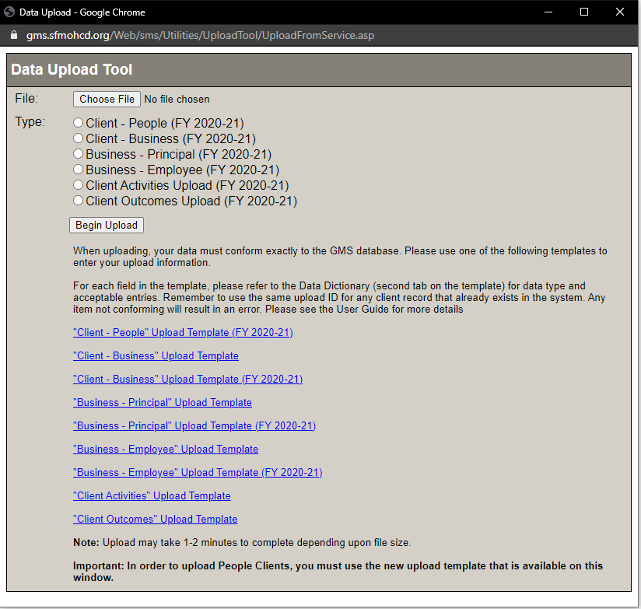
Data Upload Tool
Go to your project page, and then select the Upload tab
The Data Upload Tool should automatically pop-up

Slide 4
Client – People Upload Template
Click the “Upload” tab in the specific project page you want to upload clients for
Download “Client-People” template from the data upload window
The template should open in Excel
Use the sample row as review for the required fields
If you are entering a returning client, match the exact Upload ID as the first time they were entered
When you re-upload the template, delete the sample row, and ensure you’re selecting the same type of file as your template
Select “Client-People” and then “Begin Upload”
You can confirm your upload worked by going to the “Clients” tab, selecting “View Clients” and spot checking clients

Slide 5
Client – People Required Fields
Upload ID
Last Name/Client ID
Street Address
City
State
Zip
Birthdate
Gender
Sexual Orientation
Primary Language
Family Member Count
Family Income
Family Head
Race/Ethnicity*
*Use“1” to populate this field. More information about the new Race/Ethnicity fields can be found in the Data and Reporting Training webinar, found at https://sfmohcd.org/grantees-training.

Slide 6
Client – People Template Errors
After you select “Begin Upload” scroll down the window to the “Results” portion to see if your upload was successful
If your file gets rejected, you can scroll down to see how many rows were flagged, and open the generated spreadsheet under the Validation section titled “MissingRequiredFields.xls”
You can re-upload just the rows with errors in a new template
Common fixes for errors:
Ensure value fields align with type in Data Dictionary
Ensure fields are not left blank
Use drop-down values when available

Slide 7
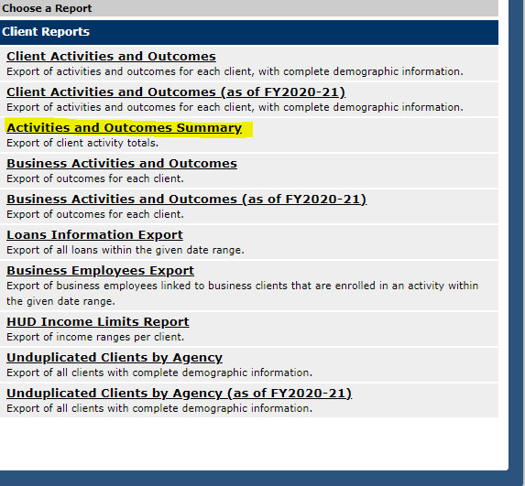
Client Activity and Outcome IDs
You can download a list of Activity IDs and Outcome IDs by opening a specific project, selecting the “Client Reports” tab, and then downloading the “Activities and Outcomes Summary” report.
You can also find the Project ID in this report
The report should open in Excel; select “Yes” on the warning that pops up prior to opening

Slide 8
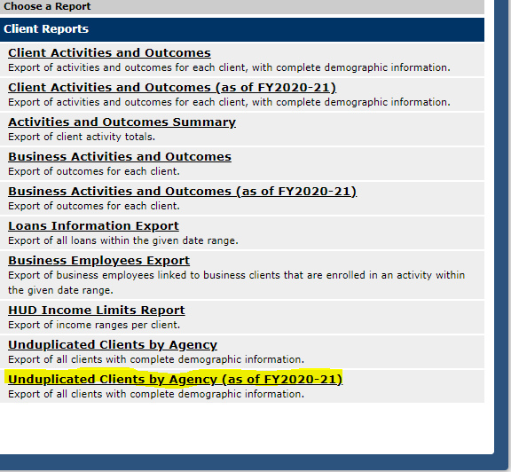
Unduplicated Client Report – Upload IDs
You can download a list of Upload IDs by opening a specific project, selecting the “Client Reports” tab, and then downloading the “Unduplicated Clients by Agency (as of FY2020-21).
Then, select “People Clients” and then Generate

Slide 9
Client – Activities Upload Template
Click the “Upload” tab in the specific project page you want to link clients to activities for
Download the “Client – Activities Upload Template (All Years)”
Enter the client’s same “UploadID” as from when you input them in the system, and then grab the appropriate “ActivityID” from the Activity and Outcomes summary report (previous slide), and input that into the template.
Then, delete sample row, and upload the template - make sure you select the right Type of upload. In this case, “Client Activities Upload (FY20-21)”
Scroll down to the Results section and make sure your upload went through
If you have multiple projects in GMS, you must use a separate upload template for each project

Slide 10
Client – Outcomes Upload Template
Click the “Upload” tab in the specific project page you want to link clients to activities for
Download the “Client – Outcomes Upload Template (All Years)”
Enter the client’s same “UploadID” as from when you input them in the system, and the same “ActivityID” from the Client – Activities template, and the appropriate “Outcome ID” (which you can get from the Activities and Outcomes summary report (slide 7)
Outcome Date will need to be after the Activity Date in order for upload to go through
Then, delete sample row, and upload the template - make sure you select the right Type of upload. In this case, “Client Outcomes Upload (FY20-21)”
Scroll down to the Results section and make sure your upload went through
If you have multiple projects in GMS, you must use a separate upload template for each project

Slide 11
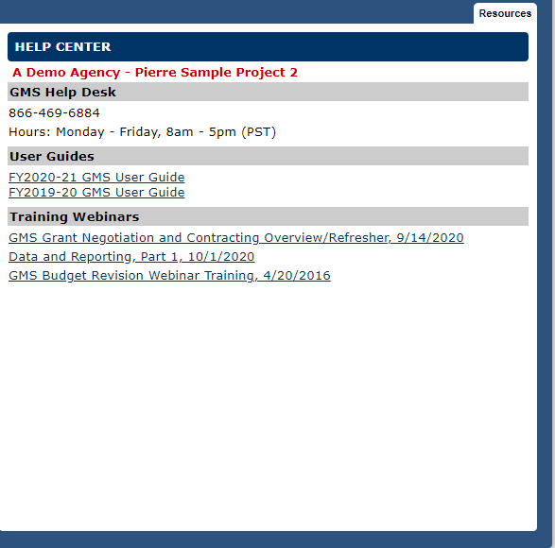
Conclusion
For GMS assistance, you can find a Help Center with support numbers and the links to these webinars in your project page in GMS, under the tab “GMS Help”
These webinars will also be available along with other resources at sfmohcd.org/grantees
For specific issues that cannot be resolved with the webinars or user guides, please feel free to reach out to your grant coordinator at MOHCD for further technical assistance
Thank you!

